Slide 1

Project Title:
Gold price prediction for the next 30 days
Name of the team | P_118 Group_2
Date of formed | 11/05/2022
Mentor | Karthik /Dhanya
Team Members | Mr. Sannapagunta satya simha reddy Mr. Vamshi M Mr. Rajesh K G Miss. Gayathri M Mr. Rohan Shet Miss. Varsha Miss Mahalakshmi
Meeting Days | Two meetings every week
Meeting Duration | 1 Hour

Slide 2

Business Objective:
Understanding the underlying structure in your dataset and coming up with a suitable forecasting model which can effectively forecast gold prices for next 30 days

Slide 3

Project Architecture / Project Flow

Slide 4
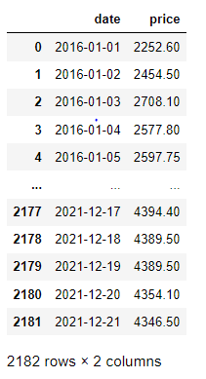
Data Set Details
2182 observations and 2 features
Dataset there is no NAN values
Date is objective type data need to convert into date time format
Price is having 1876 unique values

Slide 5

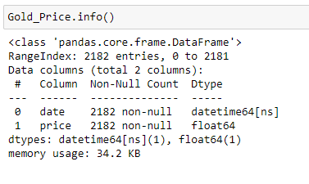
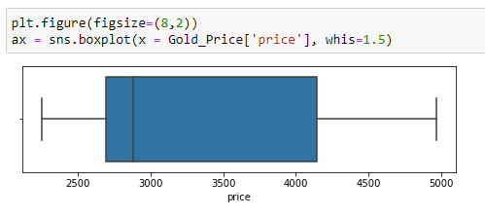
Exploratory Data Analysis(EDA)
Date is objective type data converted into date time format
Changed index in order to make it proper time serious data
No outliers present in the dataset

Slide 6
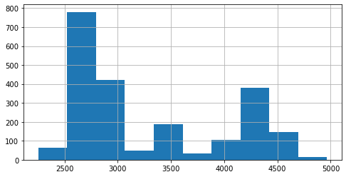
Exploratory Data Analysis(EDA)

Slide 7
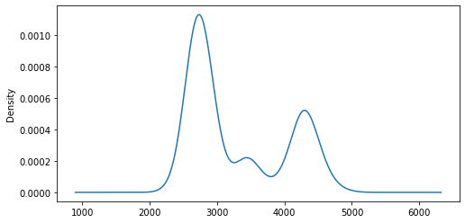
Exploratory Data Analysis(EDA)

Slide 8
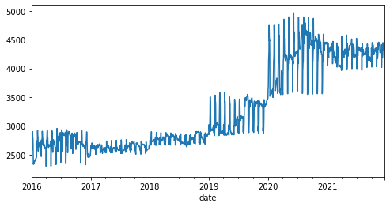
Exploratory Data Analysis(EDA)
Insight: Trend is upward or positive

Slide 9
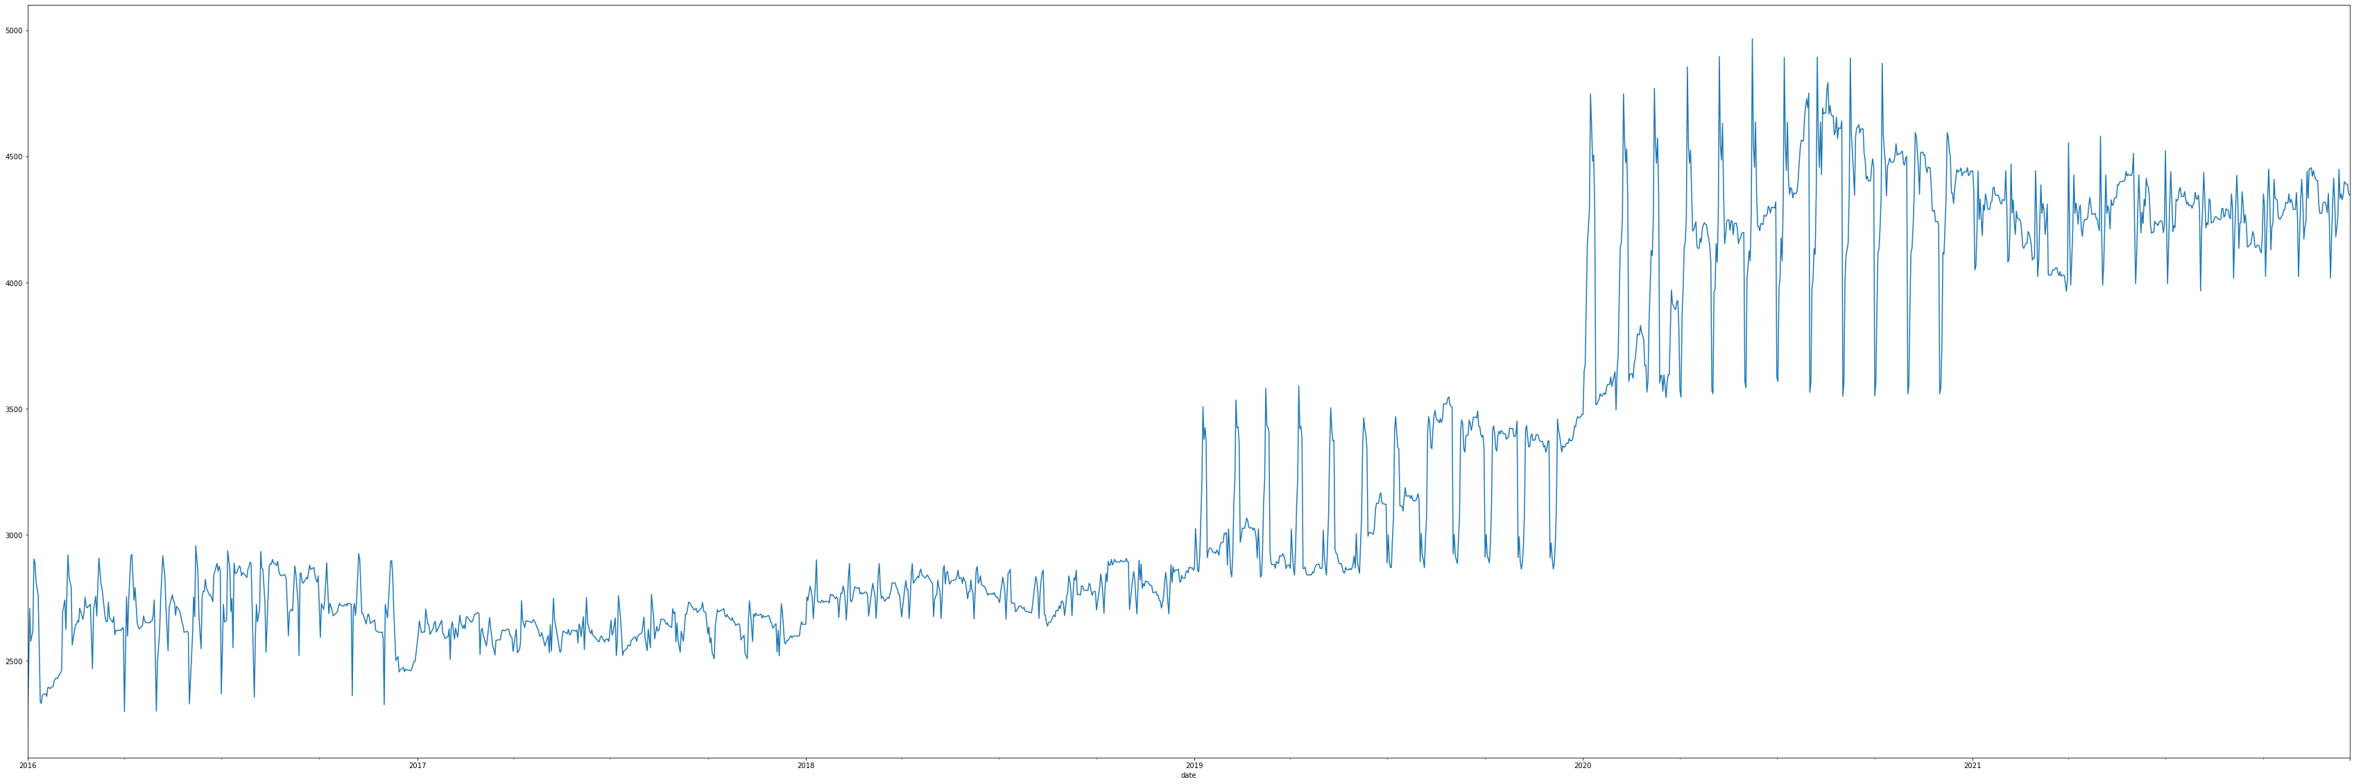
Exploratory Data Analysis(EDA)
Insight: Seasonality can be observed little bit

Slide 10
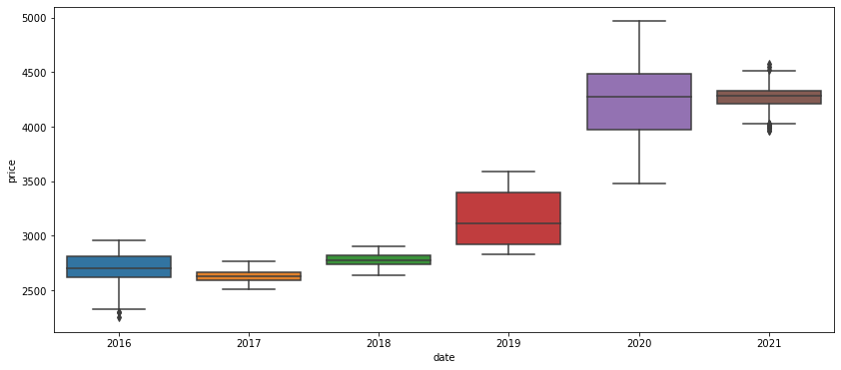
Exploratory Data Analysis(EDA)
Insight: The growth in the price has much more of an exponential growth

Slide 11
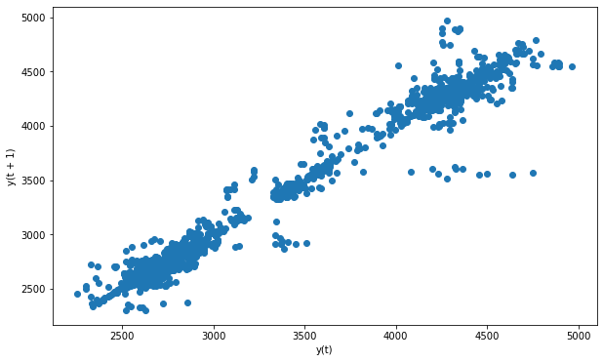
Exploratory Data Analysis(EDA)
Since our data is univariate we cannot compare between two variables, So we need to look into the Lag plot which is nothing but the plotting of value against its lagged value
Lag = 1

Slide 12
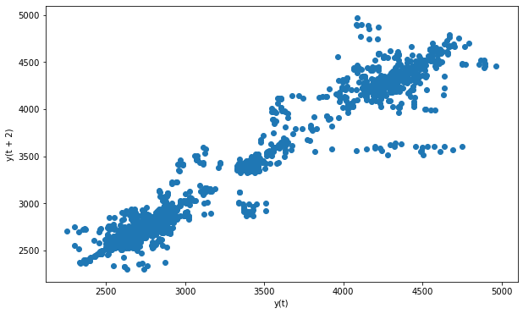
Exploratory Data Analysis(EDA)
Lag = 2

Slide 13
Exploratory Data Analysis(EDA)
Lag = 3

Slide 14
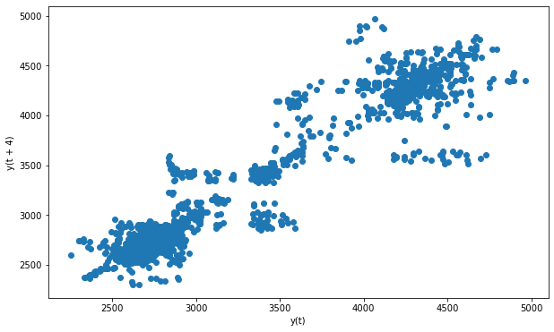
Exploratory Data Analysis(EDA)
Lag = 4
Insight: From lag_1,2,3 & 4 suggest the positive correlation

Slide 15
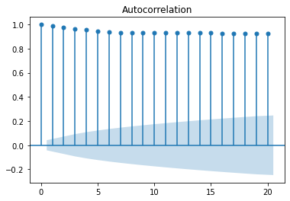
Exploratory Data Analysis(EDA)
Insight : Autocorrelation plot suggest that immediate lags have significate relationship to build a good forecasting model

Slide 16
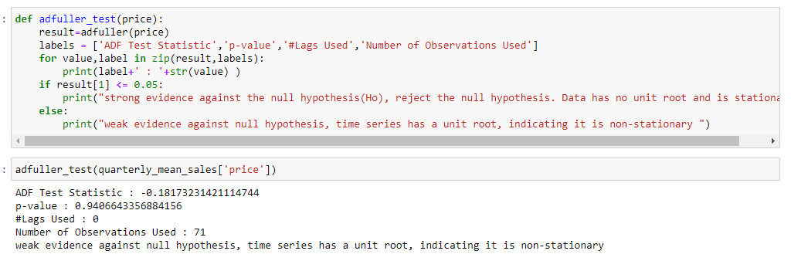
Checking for data stationality
Dickey fuller test

Slide 17
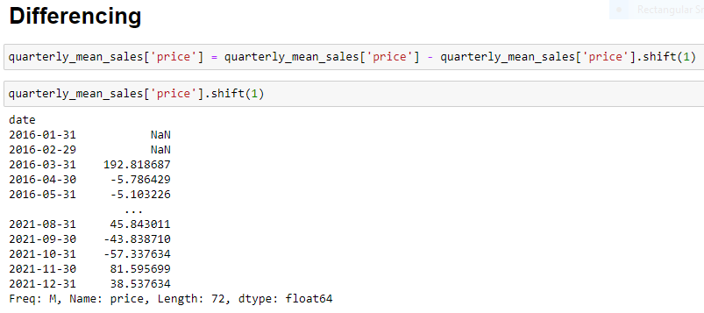

Slide 18
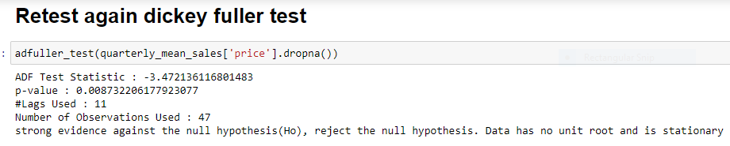
Converted data into stationary form

Slide 19
Model Building
In this project, We investigate the usage of different models to predict the gold price
Time Series Models
Linear
Exponential
Quadratic
Additive seasonality
Additive seasonality with quadratic trend
Multiplicative seasonality
Multiplicative with additive seasonality
ARIMA

Slide 20
Model Building On Gold Price Data
Model-1: Linear
RMSE : 220.46394043
Model-2: Exponential
RMSE : 236.8188138

Slide 21
Model-3: Quadratic
RMSE : 211.8204754
Model-4: Additive Seasonality
RMSE : 174.7538814

Slide 22
Model-5: Additive Seasonality With Quadratic Trend
RMSE : 209.5781670
Model-6: Multiplicative Seasonality
RMSE : 188.1787097

Slide 23
Model-7: Multiplicative With Additive Seasonality
RMSE : 240.6005109
Model-8: ARIMA – Walk forward validation
RMSE : 79.280

Slide 24
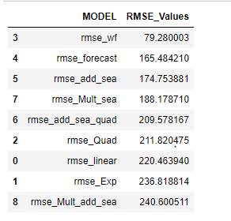
Algorithm Vs RMSE

Slide 25
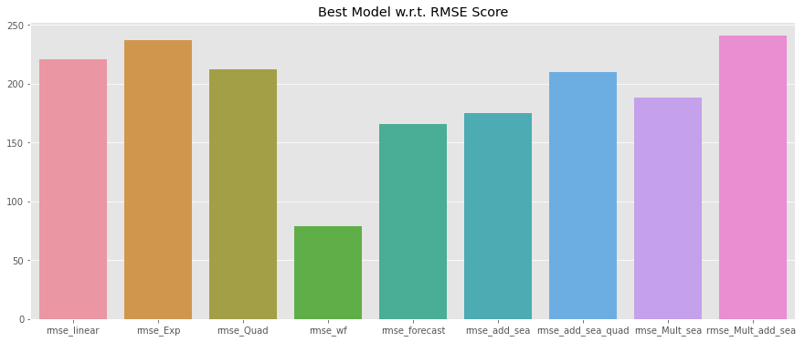
Algorithm Vs RMSE

Slide 26
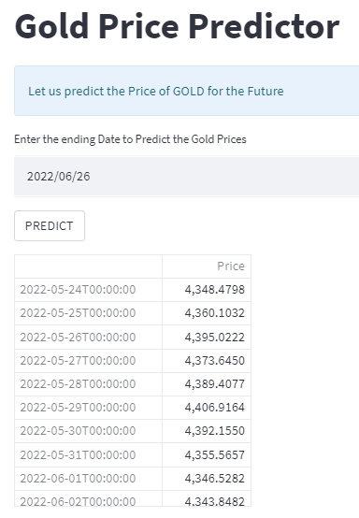
Forecasted gold price for next 30 days

Slide 27
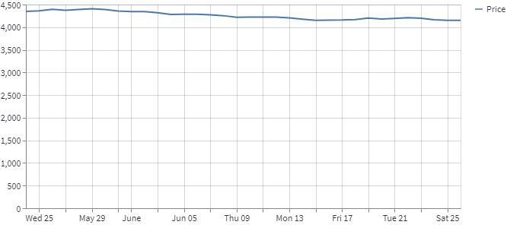
Forecasted gold price for next 30 days

Slide 28


